Slide 1
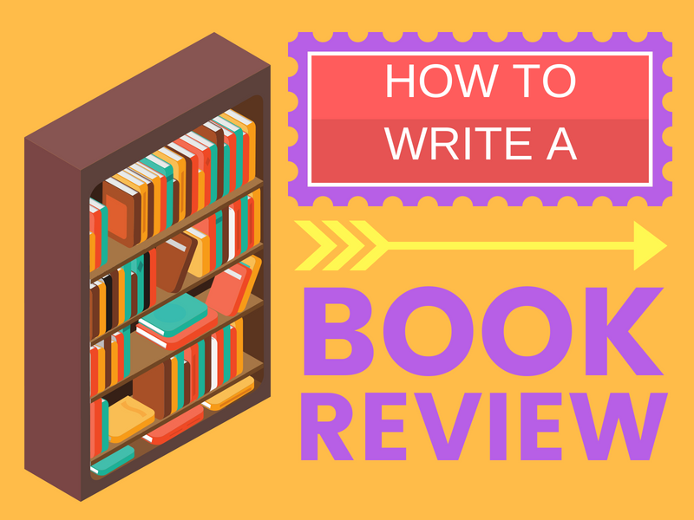

Slide 2
BOOK REVIEW
A book review is a form of literary criticism in which a book is merely described or analysed based on content, style and merit. A book review conveys an opinion , supporting it with evidence from the book.

Slide 3
CONSIDER THE FOLLOWING :
•Title- what does it suggest?
•Introduction- Provides important information about the author’s intentions or the scope of the book
•Table of contents
•What was the book about?

Slide 4
POINTS TO PONDER AS YOU READ ENTIRE BOOK :
•What’s the genre?
•From what point of view is the book written?
•Make notes as you read.
•Who is your favourite character?

Slide 5
FORMAT OF A BOOK REVIEW
Pre- writing
Remember and take notes of the plot of the story. What impression did it produce on you?
Writing
▪Introduction:
1) Give the title and write about author of the book
2) Genre of the book

Slide 6
Main Body of Book Review
1. Summarize the plot in a few sentences.
2. Mention the setting: the place and time of the plot.
3. Say something about the main characters.
4. Say something about the content.

Slide 7
Conclusion
1. Comment on the book.
2. Let others know whether or not you liked the book
3. Why do you like it? Why don't you like it?
4. Is the author's style good or bad, is the book interesting or boring etc.
5. Do you want to recommend the book?

Slide 8
Post-writing Work
Edit your writing.

Slide 9
LIST OF BOOKS FOR BOOK REVIEW :
•Matilda by Roald Dahl
•Esiotrot by Roald Dahl
•The once and Future King by TH White
•The Earthsea Triology by Ursula Le guin
•The Diary of Anne Frank by Anne Frank
•The Adventures of Sherlock Holmes by Arthur Conan Doyle
•The Secret Garden by Frances Hodgson
•Rich Dad Poor Dad by Robert Kiyosaki
•The Lord of the Rings by J.R.R. Tolkien
•The Alchemist by Paulo Coelho
•Wings of Fire by APJ Abdul Kalam
•The Goal by Eliyahu M. Goldratt and Jeff Cox

Slide 10
USEFUL EXPRESSIONS
Title, Author
The book is written by ...
Setting
The story takes place in...
Characters and Plot
The main characters are ...
The story is about ....
The book tells the story of ...
In the course of the book, the action develops dramatically…
The book begins with...
The book has an unexpected ending…
The ending of the book is …

Slide 11
USEFUL EXPRESSIONS
Reaction
I am impressed by
I think ....
The book is terribly / beautifully written
What surprised me is ...
What I liked is...
What I didn't like is...
I liked/didn't like the book because ...

